Slide 1
Household Behavior and Consumer Choice
A Presentation by
Anamitra Roy

Slide 2
Goals of Economic Decision Makers
Consumers
Maximize their individual well-being, subject to their choices being feasible.
Firms
Maximize their profits, subject to being able to sell what they produce at the price they charge.
Governments
Maximize social welfare, subject to the responses (consumption, labor supply, investment and production) of individuals and firms.

Slide 3



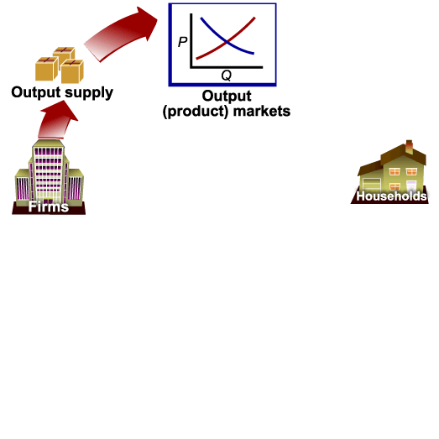
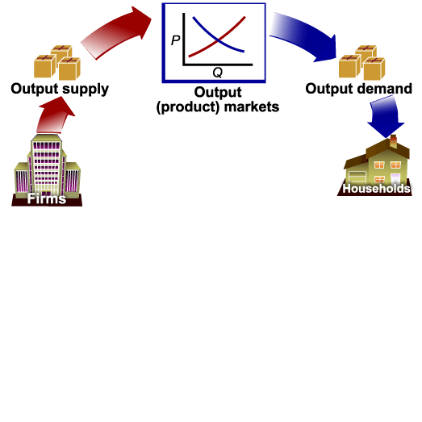
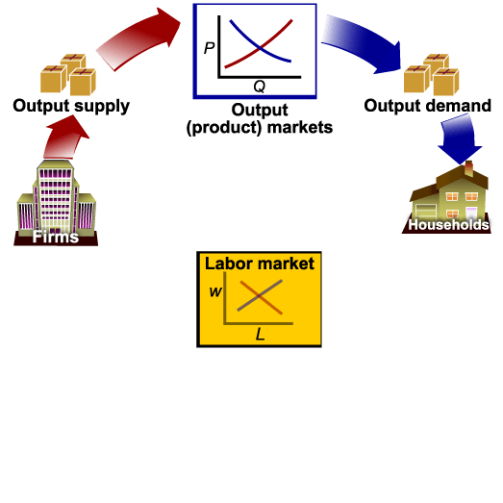





Firms and Household Decisions

Slide 4

Household Choice in Output Markets
Every household must make three basic decisions:
  How much of each product, or output, to demand?
  How much labor to supply?
  How much to spend today and how much to save for the future?

Slide 5
Determinants of Household Demand
Factors that influence the quantity of a given good or service demanded by a single household include:
The price of the product in question.
The income available to the household.
The household’s amount of accumulated wealth.
The prices of related products available to the household.
The household’s tastes and preferences.
The household’s expectations about future income, wealth, and prices.

Slide 6
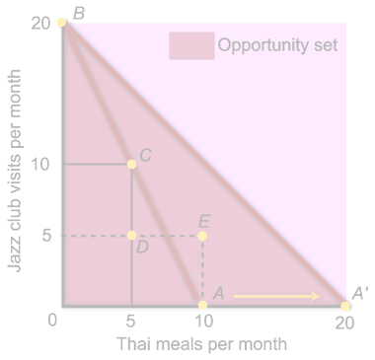
The Budget Constraint
The budget constraint refers to the limits imposed on household choices by income, wealth, and product prices.
A choice set or opportunity set is the set of options that is defined by a budget constraint.
Notes:
Information of household income and wealth, together with information on product prices, makes it possible to distinguish those combinations of goods and services that are affordable from those that are not.

Slide 7
Choice Set or Opportunity Set
Possible Budget Choices of a Person Earning $1,000 Per Month After Taxes
 |  |  | MONTHLY |  |  |  | OTHER
OPTION |  |  | RENT | FOOD |  |  | EXPENSES |  |  | TOTAL |  | AVAILABLE?
A |  | $ | 400 | $250 |  |  | $350 |  | $1,000 |  | Yes
B |  |  | 600 | 200 |  |  |  | 200 | 1,000 |  | Yes
C |  |  | 700 | 150 |  |  |  | 150 | 1,000 |  | Yes
D |  |  | 1,000 | 100 |  |  |  | 100 | 1,200 |  | No
The real cost of a good or service is its opportunity cost, and opportunity cost is determined by relative prices.

Slide 8
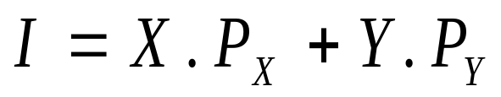
The Budget Constraint
When a consumer’s income is allocated entirely towards the purchase of only two goods, X and Y, the consumer’s income equals:
where: I = consumer’s income
X = quantity of good X purchased
Y = quantity of good Y purchased
P_{X} = price of good X
P_{Y} = price of good Y

Slide 9
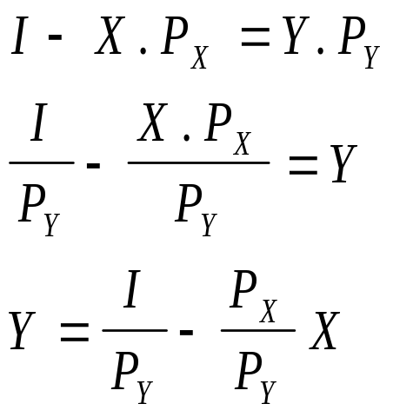
The Budget Line
The budget line shows the maximum quantity of two goods, X and Y, that can be purchased with a fixed amount of income, expressed as Y= f(X).
We can derive the budget line by rearranging the terms in the income equation, as follows:
Budget Line

Slide 10
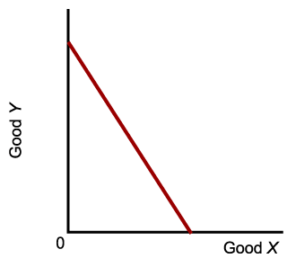
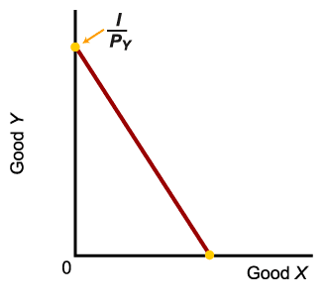
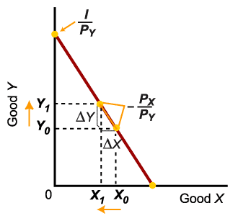
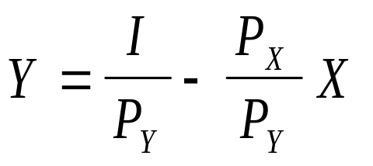
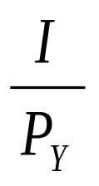
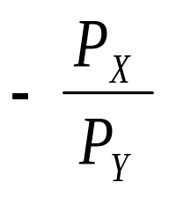
The Budget Line
The Y-intercept of the budget line shows the amount of good Y that can be purchased when all income is spent on good Y.
The slope of the budget line equals the ratio of the goods’ prices.

Slide 11
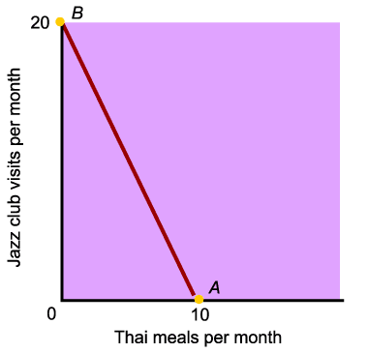
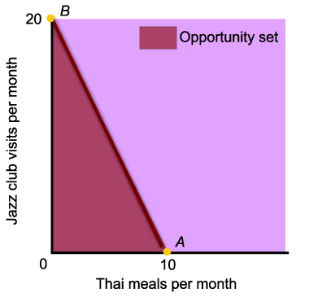
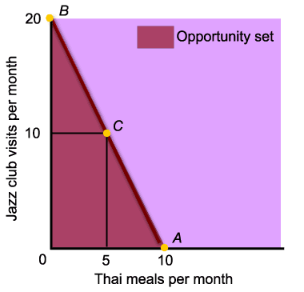
The Budget Line
This is the budget constraint when income equals $200 dollars per month, the price of a jazz club visit is $10 each, and the price of a Thai meal is $20.
One of the possible combinations is 5 Thai meals and 10 Jazz club visits per month.

Slide 12
The Budget Constraint
A budget constraint separates those combinations of goods and services that are available, given limited income, from those that are not. The available combinations make up the opportunity set.
Notes:
Information of household income and wealth, together with information on product prices, makes it possible to distinguish those combinations of goods and services that are affordable from those that are not.

Slide 13
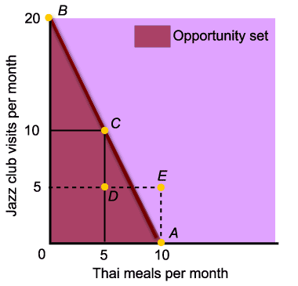
The Budget Line
Point E is unattainable, and point D does not exhaust the entire income available.

Slide 14
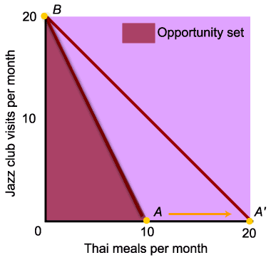
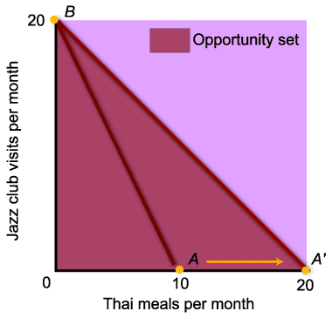
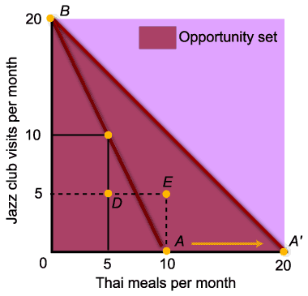
The Budget Line
A decrease in the price of Thai meals shifts the budget line outward along the horizontal axis.
The decrease in the price of one good expands the consumer’s opportunity set.

Slide 15
What is Utility?
Utility is the satisfaction, or reward, a product yields relative to its alternatives. The basis of choice.
unit of measuring utility ---- Util

Slide 16
Cardinal Utility vs. Ordinal Utility
Cardinal Utility: Assigning numerical values to the amount of satisfaction
Ordinal Utility: Not assigning numerical values to the amount of satisfaction but indicating the order of preferences, that is, what is preferred to what

Slide 17
Total Utility
The amount of satisfaction obtained by consuming specified amounts of a product per period of time.
Example: TU(X) = U(X) = 16 X – X²
where X is the amount a good that is consumed in a given period of time.
5 units of the product per period of time yields 55 utils of satisfaction

Slide 18
Marginal Utility
The change in total utility (ΔTU) resulting from a one unit change in consumption (ΔX).
MU = ΔTU/ ΔX

Slide 19
Calculating MU from a TU Function
Example: TU(X) = 16 X – X²
MU = dTU/dX = 16-2X
In general, the derivative of a total function is the marginal function.
The marginal function is the slope of the total function.

Slide 20
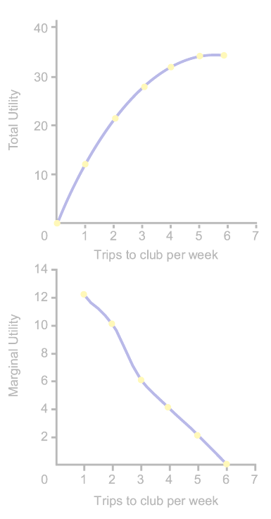
Diminishing Marginal Utility
The law of diminishing marginal utility:
  The more of one good consumed in a given period, the less satisfaction (utility) generated by consuming each additional (marginal) unit of the same good.

Slide 21
Graphs of Total Utility & Marginal Utility
Total Utility
TU
X₁ is where marginal utility reaches its maximum.
This is where we encounter diminishing marginal utility.
The slope of TU has reached its maximum; TU has an inflection point here.
X₁ X₂
X
Marginal Utility
X₂ is where total utility reaches its maximum.
MU is zero.
This is the saturation point or satiation point.
After that point, TU falls and MU is negative.
MU
X₁ X₂
X

Slide 22
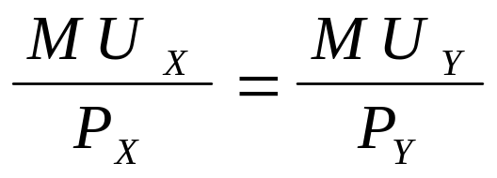
The Utility-Maximizing Rule
Utility-maximizing consumers spread out their expenditures until the following condition holds:
where: MU_{X} = marginal utility derived from the last unit of X consumed.
MU_{Y} = marginal utility derived from the last unit of Y consumed.
Y = quantity of Y purchased
P_{X} = price of good X
P_{Y} = price of good Y

Slide 23
Allocation of Fixed Expenditure Per Week Between Two Alternatives
(1) TRIPS TO CLUB PER WEEK |  | (2) TOTAL UTILITY | (3) MARGINAL UTILITY (MU) |  |  | (4) PRICE (P) |  | (5) MARGINAL UTILITY PER DOLLAR (MU/P)
1 |  | 12 | 12 |  |  | $ | 3.00 | 4.0
2 |  | 22 | 10 |  |  |  | 3.00 | 3.3
3 |  | 28 | 6 |  |  |  | 3.00 | 2.0
4 |  | 32 | 4 |  |  |  | 3.00 | 1.3
5 |  | 34 | 2 |  |  |  | 3.00 | 0.7
6 |  | 34 | 0 |  |  |  | 3.00 | 0
(1) BASKETBALL GAMES PER WEEK |  | (2) TOTAL UTILITY | (3) (MU) |  |  | (4) (P) |  | (5) (MU/P)
1 |  | 21 | 21 |  |  | $ | 6.00 | 3.5
2 |  | 33 | 12 |  |  |  | 6.00 | 2.0
3 |  | 42 | 9 |  |  |  | 6.00 | 1.5
4 |  | 48 | 6 |  |  |  | 6.00 | 1.0
5 |  | 51 | 3 |  |  |  | 6.00 | .5
6 |  | 51 | 0 |  |  |  | 6.00 | 0

Slide 24
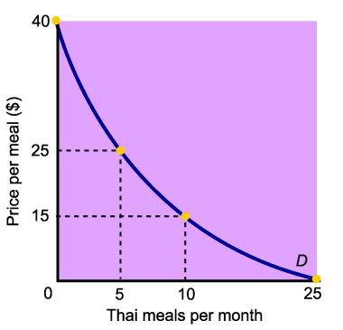
Diminishing Marginal Utility and Downward-Sloping Demand
Diminishing marginal utility helps to explain why demand slopes down.
Marginal utility falls with each additional unit consumed, so people are not willing to pay as much.

Slide 25
  Indifference curve
Locus of combinations of two goods giving equal
level of utility to the consumer
Good
Y
Indifference curve
Good
X

Slide 26
  Properties of Indifference curve
i.IC will be downward sloping
ii.IC is convex to the origin
iii. Two IC can not cut or touch each other
iv.Higher IC represents higher level of utility

Slide 27
Indifference Map
Map consisting several ICs each representing unique level of utility derived from different combinations of the two goods consumed.
Units of good Y
I₅
I₄
I₃
I₂
I₁
O
Units of good X

Slide 28
Optimum consumption
r
Points r, s, u and v give a lower level of utility than point t.
s
Units of good Y
Point t gives the maximum level of utility
Y₁
t
u
I₅
I₄
v
I₃
I₂
I₁
O
X₁
Units of good X

Slide 29
Consumers Equilibrium
Objective: Maximization of utility subject to budget constraint.
Equilibrium condition:
i.Necessary condition:MRS_{XY} =Price Ratio
ii.Sufficient condition: IC is convex at the point of tangency

Slide 30
Price Effect
Qy
A
U”
U’
Qx
Qx’
B
Qx”
C
Change in the optimum level of consumption arising out of the change in the price of the of one commodity( other things remaining constant).

Slide 31
Income and Substitution Effects
Price changes affect households in two ways:
The income effect: Consumption changes because purchasing power changes.
The substitution effect: Consumption changes because opportunity costs change.

Slide 32
Income Effect
INCOME EFFECT: Change in the optimum level of consumption arising out of the change in the real income of the consumer (other things remaining constant).

Slide 33
The Income Effect of a Price Change
When the price of a product falls, a consumer has more purchasing power with the same amount of income.
When the price of a product rises, a consumer has less purchasing power with the same amount of income.

Slide 34
The Substitution Effect of a Price Change
When the price of a product falls, that product becomes more attractive relative to potential substitutes.
When the price of a product rises, that product becomes less attractive relative to potential substitutes.

Slide 35
Income and Substitution Effects of a Price Change
Price of a good or service
Household is better off |  | Income effect |  | Household buys more
Opportunity cost of the good falls |  | Substitution effect |  | Household buys more
Household is worse off |  | Income effect |  | Household buys less
Opportunity cost of the good rises |  | Substitution effect |  | Household buys less
FALLS
RISES

Slide 36
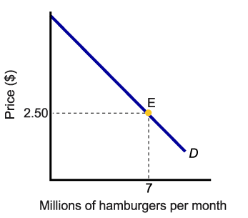
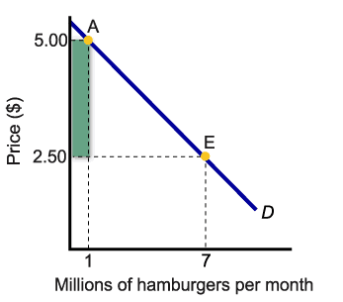
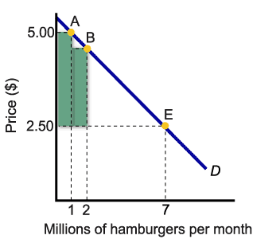
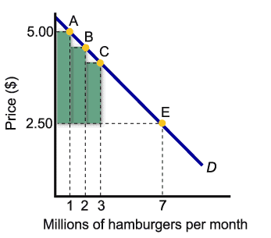
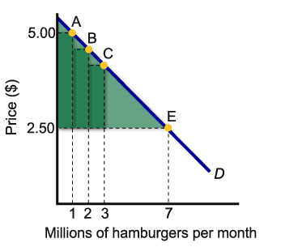
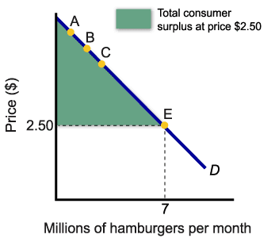
Consumer Surplus
Consumer surplus is the difference between the maximum amount a person is willing to pay for a good and its current market price.
Consumer surplus measurement is a key element in cost-benefit analysis.

Slide 37
Consumer’s surplus
Buyer’s willingness to pay = maximum price he is willing to pay
A point on a demand curve reflects the willingness to pay of some buyers.
Demand curve is downward sloping because as you are lowering the market price, more people whose willingness to pay is lower, enters the market.
Consumer’s surplus = willingness to pay – actual price buyer pays in a market, measures the benefits to buyers of participating in a market.
Consumer surplus is measured as the area below the demand curve above the market price.

Slide 38
Market Demand Curve, Price and Consumer Surplus
Price
If quantity demanded
is perfectly divisible
we have this smooth linear
demand curve.
A
Initial
consumer
surplus
Consumer surplus to new consumers
P₁
C
B
P₂
F
D
E
Additional consumer surplus to initial consumers
Demand
0
Q₁
Q₂
Quantity
Notes:
21
17

Slide 39
The Diamond/Water Paradox
The diamond/water paradox states that:
the things with the greatest value in use frequently have little or no value in exchange, and
the things with the greatest value in exchange frequently have little or no value in use.

Slide 40
Thank You

